Slide 1
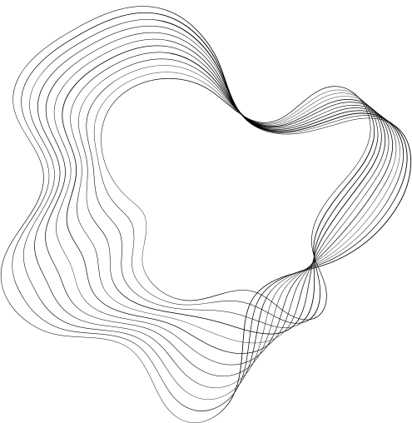

SOK
PRACTICES EMPLOYED IN THE NEURAL CRYPTANALYSIS OF
ciphers
NORICA BACUIETI

Slide 2
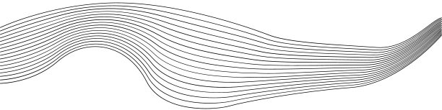
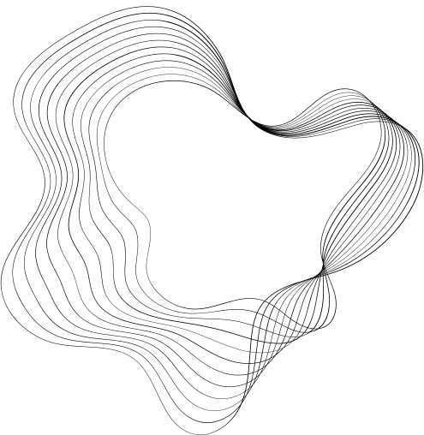
CONTENT
1
INTRODUCTION
2
PURPOSE
3
BACKGROUND & QUESTIONS
a
DATASETS
b
NEURAL DISTINGUISHERS
c
EXPLAINABILITY
d
EVOLUTIONARY ALGORITHMS
4
EXPERIMENTS

Slide 3
INTRODUCTION
(C1 , C2)
In 2019, Gohr published a paper where for the first time, a neural network was successfully used to perform distinguishing attacks against a round-reduced version of a modern block cipher that were competitive to the then-published state-of-the-art.
ResNet
For a chosen input difference ∆, he defined:
real pairs: (C1, C2) from (P1, P2) where P1 ⊕ P2 = ∆
random pairs: (C1, C2) from (P1, P2) where P1 ⊕ P2 = random
p ∈ [0,1]
He aimed to distinguish the real pairs from the random pairs using a residual neural network and presented his findings.
p >= 0.5: (C1, C2) is real
p < 0.5: (C1, C2) is random
3

Slide 4
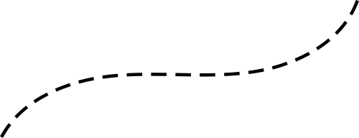
INTRODUCTION
(C1 , C2)
High accuracy
Neural
distinguisher
Explainer
High accuracy
There is a weakness
Information about
the identified weakness
4

Slide 5

PURPOSE
This thesis aims to systemize the knowledge and practices present in the cryptanalysis of ciphers
using neural networks and to verify whether some of those practices can be generalized across datasets,
ciphers, and neural networks.
5

Slide 6
BACKGROUND & QUESTIONS
01
02
03
04
DATASETS
NEURAL
DISTINGUISHERS
EXPLAINABILITY
EVOLUTIONARY ALGORITHMS
6

Slide 7
01
DATASETS
Type of input
Input difference
Input shape
7

Slide 8


01
DATASETS
Type of input
PAIRS: (C1,C2)
8

Slide 9

01
DATASETS
Type of input
DIFFERENCES: C1 ⊕ C2
Will training on ciphertext pairs generally lead to better performance than training on ciphertext differences, irrespective of the cipher and provided that a strong enough neural distinguisher is used?
PAIRS: (C1,C2)
QUESTION N°1
9

Slide 10
01
DATASETS
Type of input
DIFFERENCES: C1 ⊕ C2
Will training on ciphertext pairs enhanced with information from the previous round generally lead to better performance than training on ciphertext pairs, irrespective of the cipher and provided that a strong enough neural distinguisher is used?
PAIRS: (C1,C2)
PAIRS plus: (C1,C2, ...)
QUESTION N°2
10

Slide 11
01
DATASETS
Input difference
from high prob. diff
low hamming weight
PAIRS plus: (C1,C2, ...)
BATCHES of pairs/diff
11

Slide 12
01
DATASETS
Input shape
Concatenation
Will reshaping the input to mirror the word structure of the cipher generally improve the performance of a neural distinguisher, irrespective of the cipher and neural distinguisher?
Mimic word structure
PAIRS plus: (C1,C2, ...)
QUESTION N°3
BATCHES of pairs/diff
12

Slide 13
02
NEURAL DISTINGUISHERS
Architectures
Strategies
13

Slide 14
02
NEURAL DISTINGUISHERS
Architectures
ResNet
Do some architectures work generally better for some ciphers than others? Is there an architecture that generally works well across ciphers?
MLP
ResNet with
Inception Blocks
QUESTION N°4
....
14

Slide 15
02
NEURAL DISTINGUISHERS
Strategies
Iterative training strategy
Will the iterative training strategy using AMSGrad generally help improve the performance of a neural distinguisher, irrespective of the network and cipher?
Basic training
QUESTION N°5
DBitNet
15

Slide 16
02
NEURAL DISTINGUISHERS
Strategies
Iterative training strategy
Will the freezing layer strategy generally help improve the performance of a neural distinguisher, irrespective of the network and cipher?
Basic training
Freezing
layer strategy
QUESTION N°6
DBitNet
16

Slide 17
03
EXPLAINABILITY
Explainability
Cipher specific
approaches
Will the accuracy of a (strong) neural distinguisher
(ResNet depth-1)
“be understood in terms of the correctness of
single-bit predictions” for other ciphers as well?
General approaches
NNBits
QUESTION N°7
DBitNet
17

Slide 18
EXPERIMENTS
20

Slide 19
QUESTION 1
Will training on ciphertext pairs generally lead to better performance than training on ciphertext differences, irrespective of the cipher and provided that a strong enough neural distinguisher is used?
21

Slide 20
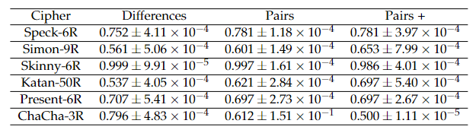
Findings
Results
Conclusions are mixed:
  Increase for:
    Speck-6R
    Simon-9R
    Katan-50R
  Decrease for:
    Skinny-6R
    Present-6R
    ChaCha-3R
Suspect that: If a stronger network was used, the performance would increase for all ciphers.
Trained using ResNet on ciphertext differences and shaped ciphertext pairs
22

Slide 21
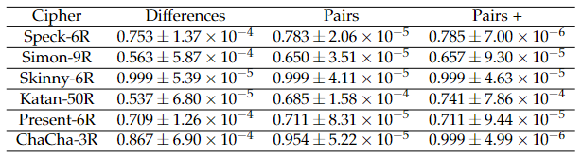
Findings
Results
Conclusions are mixed:
  Increase for:
    Speck-6R
    Simon-9R
    Katan-50R
    Skinny-6R
    Present-6R
    ChaCha-3R
Suspect that: If a stronger network was used, the performance would increase for all ciphers.
Trained using DBIT on ciphertext differences and shaped ciphertext pairs
23

Slide 22
QUESTION 1
Will training on ciphertext pairs generally lead to better performance than training on ciphertext differences, irrespective of the cipher and provided that a strong enough neural distinguisher is used?
24

Slide 23

QUESTION 1
Will training on ciphertext pairs generally lead to better performance than training on ciphertext differences, irrespective of the cipher and provided that a strong enough neural distinguisher is used?
25

Slide 24
QUESTION 2
Will training on ciphertext pairs enhanced with information from the previous round generally lead to better performance than training on ciphertext pairs, irrespective of the cipher and provided that a strong enough neural distinguisher is used?
26

Slide 25
Findings
Results
Conclusions are mixed:
  Same:
    Speck-6R
    Present-6R - expected
  Increase for:
    Simon-9R
    Katan-50R
  Decrease for:
    Skinny-6R
    ChaCha-3R
Suspect that: If a stronger network was used, the performance would increase for all ciphers - except for Present-6R.
Trained using ResNet on shaped ciphertext pairs and shaped ciphertext pairs+
27

Slide 26
Findings
Results
Conclusions are mixed:
  Same:
    Present-6R - expected
  Increase for:
    Speck-6R
    Simon-9R
    Katan-50R
    Skinny-6R
    ChaCha-3R
Suspect that: If a stronger network was used, the performance would increase for all ciphers - except for Present-6R.
Trained using DBIT on shaped ciphertext pairs and shaped ciphertext pairs+
28

Slide 27
QUESTION 2
Will training on ciphertext pairs enhanced with information from the previous round generally lead to better performance than training on ciphertext pairs, irrespective of the cipher and provided that a strong enough neural distinguisher is used?
29

Slide 28
QUESTION 2
Will training on ciphertext pairs enhanced with information from the previous round generally lead to better performance than training on ciphertext pairs, irrespective of the cipher and provided that a strong enough neural distinguisher is used?
30

Slide 29
QUESTION 3
Will reshaping the input to mirror the word structure of the cipher generally improve the performance of a neural distinguisher, irrespective of the cipher and neural distinguisher?
31

Slide 30
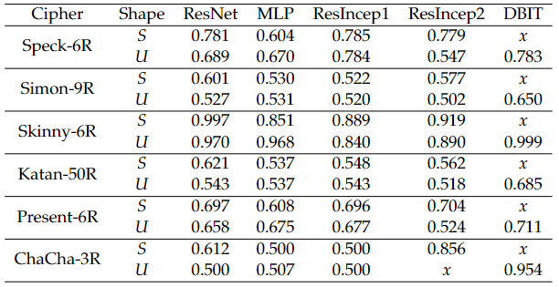
Findings
Results
Conclusions are mixed:
  Increase with SHAPED pairs:
    ResNet
    ResIncep1
    ResIncep2
  Decrease with UNSHAPED pairs:
    MLP
MLP: For shaped pairs, special measures were taken to improve the performance.
Trained using various neural networks on ciphertext pairs
32

Slide 31
QUESTION 3
Will reshaping the input to mirror the word structure of the cipher generally improve the performance of a neural distinguisher, irrespective of the cipher and neural distinguisher?
33

Slide 32



QUESTION 3
For complex neural networks
Will reshaping the input to mirror the word structure of the cipher generally improve the performance of a neural distinguisher, irrespective of the cipher and neural distinguisher?
For less complex neural networks
34

Slide 33
QUESTION 4
Do some architectures work generally better for some ciphers than others? Is there an architecture that generally works well across ciphers?
35

Slide 34
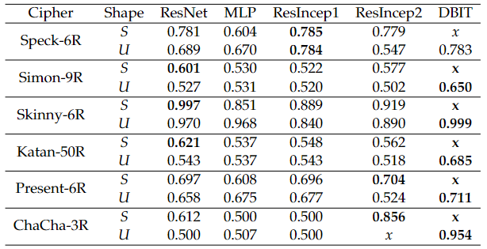
Findings
Results
Conclusions are mixed - if we consider shape:
  Speck-6R: ResIncep1
  Simon-9R: ResNet and DBIT
  Skinny-6R: ResNet and DBIT
  Katan-50R: ResNet and DBIT
  Present-6R: ResIncep2 and DBIT
  ChaCha-3R: ResIncep2 and DBIT
If we look at the results as a whole: DBIT*
Redid experiments for questions 1 and 2 with
DBIT.
Trained using various neural networks on ciphertext pairs
36

Slide 35
QUESTION 4
Do some architectures work generally better for some ciphers than others? Is there an architecture that generally works well across ciphers?
37

Slide 36
QUESTION 4
Do some architectures work generally better for some ciphers than others? Is there an architecture that generally works well across ciphers?
38

Slide 37
QUESTION 4
Do some architectures work generally better for some ciphers than others? Is there an architecture that generally works well across ciphers?
39

Slide 38
QUESTION 5
Will the iterative training strategy using AMSGrad generally help improve the performance of a neural distinguisher, irrespective of the network and cipher?
40

Slide 39
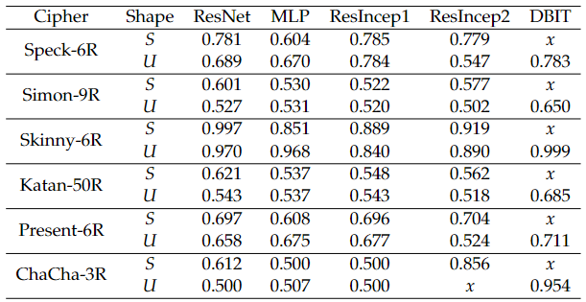
Results
Findings
Conclusions: Performance remained the same
NOT SURPRISING since similar findings were reported by Bao et al.
Freezing layer strategy
Trained using various neural networks on ciphertext pairs
41

Slide 40
QUESTION 5
Will the iterative training strategy using AMSGrad generally help improve the performance of a neural distinguisher, irrespective of the network and cipher?
42

Slide 41
QUESTION 5
Will the iterative training strategy using AMSGrad generally help improve the performance of a neural distinguisher, irrespective of the cipher?
43

Slide 42
QUESTION 6
Will the freezing layer strategy generally help improve the performance of a neural distinguisher, irrespective of the network and cipher?
44

Slide 43
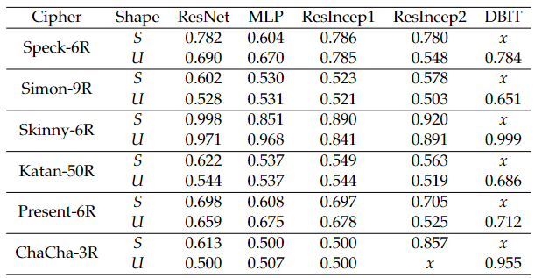
Results
Findings
Conclusions:
  Performance increased by 0.001 for the complex networks
  Performance stayed the same for MLP
NOT SURPRISING since, for MLP, there is no clear separation between the feature extractor and the classifier, separation that exists for the other networks.
Trained using various neural networks on ciphertext pairs
45

Slide 44
QUESTION 6
Will the freezing layer strategy generally help improve the performance of a neural distinguisher, irrespective of the network and cipher?
46

Slide 45
For networks with a clear separation between the feature extractor and the classifier
QUESTION 6
Will the freezing layer strategy generally help improve the performance of a neural distinguisher, irrespective of the cipher?
For neural networks with no clear separation
47

Slide 46
QUESTION 7
Will the accuracy of a (strong) neural distinguisher
(ResNet depth-1)
“be understood in terms of the correctness of
single-bit predictions” for other ciphers as well?
48

Slide 47
Results
In a previous work
NNBits managed to:
  By training an MLP network on the single-bit predictions, the authors managed to recover almost all the accuracy of ResNet depth-1: recovered 78.1% vs actual 78.3%
  The authors concluded that “the largest part of the accuracy of Gohr’s network can be understood in terms of the correctness of single-bit predictions”.
Cipher
Recovered
Actual (ResNet)
Speck-6R
78.1%
78.3%
49

Slide 48
Results
Findings
For Simon-9R:
  The MLP network using single-bit predictions managed to recover only 51.76% instead of 60.1%
Cipher
Recovered
Actual (ResNet)
Speck-6R
78.1%
78.3%
Simon-9R
51.76%
60.1%
50

Slide 49
Results
Findings
For Katan-50R - similar to Simon-9R:
  The MLP network using single-bit predictions managed to recover only 56.32% instead of 62.1%
I noticed: The higher the actual accuracy, the more it is recovered.
Suspect: The actual accuracy of around 80%, i.e., like for Speck-6R, to recover it
Cipher
Recovered
Actual (ResNet)
Speck-6R
78.1%
78.3%
Simon-9R
51.76%
60.1%
Katan-50R
56.32%
62.1%
51

Slide 50
Results
Findings
For Speck-7R - similar to Speck-6R:
  This time, the depth-1 ResNet obtains an accuracy of 61.6%, i.e., lower than for Speck-6R.
  Still,
    Surprisingly, the MLP network using single-bit predictions recovered the same accuracy as the ResNet: 61.6%.
Suspicion not confirmed.
Cipher
Recovered
Actual (ResNet)
Speck-6R
78.1%
78.3%
Simon-9R
51.76%
60.1%
Katan-50R
56.32%
62.1%
Speck-7R
61.6%
61.6%
52

Slide 51
Results
Findings
New suspicion: The ability of the MLP network using single-bit predictions to recover the accuracy might depend on the cipher.
Cipher
Recovered
Actual (ResNet)
Speck-6R
78.1%
78.3%
Simon-9R
51.76%
60.1%
Katan-50R
56.32%
62.1%
Speck-7R
61.6%
61.6%
53

Slide 52
Results
Findings
For Simon-8R - similar to Simon-9R:
  This time, the depth-1 ResNet obtains an accuracy of 71.3%, i.e., higher than that for Speck-7R
  Still,
    The MLP network using single-bit predictions recovered only 56.32%.
Accuracy was not reached, confirming that the results are cipher-dependent.
Cipher
Recovered
Actual (ResNet)
Speck-6R
78.1%
78.3%
Simon-9R
51.76%
60.1%
Katan-50R
56.32%
62.1%
Speck-7R
61.6%
61.6%
Simon-8R
56.32%
71.3%
54

Slide 53
Results
Findings
Still, the MLP network performed better than random guessing for both Simon-8/9R and Katan-50R, which means that at least, for a small part, Gohr’s neural distinguisher’s accuracy included the correctness of single-bit predictions.
Cipher
Recovered
Actual (ResNet)
Speck-6R
78.1%
78.3%
Simon-9R
51.76%
60.1%
Katan-50R
56.32%
62.1%
Speck-7R
61.6%
61.6%
Simon-8R
56.32%
71.3%
55

Slide 54
QUESTION 7
Will the accuracy of a (strong) neural distinguisher
(ResNet depth-1)
“be understood in terms of the correctness of
single-bit predictions” for other ciphers as well?
56

Slide 55
But only a small part could be understood/explained in this way
QUESTION 7
Will the accuracy of a (strong) neural distinguisher
(ResNet depth-1)
“be understood in terms of the correctness of
single-bit predictions” for other ciphers as well?
57

Slide 56
CONCLUSIONS
The more information a (strong) neural distinguisher is given to train on, the better its performance is.
The way one reshapes the ciphertexts matters for achieving a better-
performing neural distinguisher and is dependent on the neural distinguisher’s complexity.
The DBitNet neural network of Bellini et al. appears to offer the best* overall performance on the studied ciphers.
58

Slide 57
CONCLUSIONS
The iterative training strategy of Bellini et al. for improving a neural distinguisher’s performance does not seem to help.
The freezing layer strategy of Bao et al., even if the improvement is minor, does improve a neural distinguisher’s performance, given that there is a clear separation between the feature extractor and the classifier of the neural distinguisher.
NNBits of Habitzer et al. could not recover ResNets’ performance completely using (only) single-bit predictions for Simon or Katan despite being able to do that for Speck, meaning that ResNet bases its decision on more than the correctness of single-bit predictions for the two aforementioned ciphers.
59

Slide 58
THANK YOU!

